Slide 1

Business Model Canvas
Document prepared in accordance with the regulations in effect as of September 19, 2024.
Business Model CAnvas
Business Model Canvas
Business Model Canvas

Slide 2






Summary
1.0 Business Model:
1.1 The context in which the business model emerged (6-8) 1.2 The nine building blocks of a business model (9-38)
2.0 Business Model Canvas:
2.1 How and why to apply the business model canvas to your business (42 -44)
2.2 A case study (46-47)
2.3 The Business Model Canvas and the brain (49-50)
Osterwalder, Alexander and Yves Pigneur. Business

Slide 3
1.0.
Canvas
Business Model

Slide 4
/Canvas
Business Model

Slide 5
/Canvas
Business Model

Slide 6

Osterwalder, Alexander and Yves Pigneur.
1.1.
Business Model

Slide 7
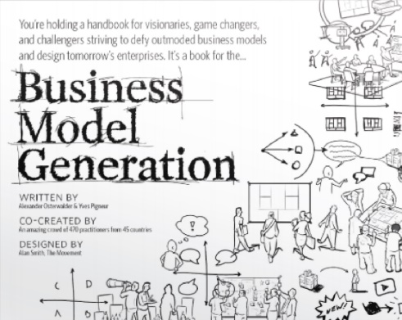
Osterwalder, Alexander and Yves Pigneur.
Business Model
Business Model Generation. (2010)

Slide 8

Osterwalder, Alexander and Yves Pigneur.
Business Model
9 “blocks”
Business Model Generation. (2010)

Slide 9
Business Model
1.2.
The
9 “blocks”

Slide 10
The
9 “blocks”
Customer
Segments

Slide 11
The
9 “blocks”
Customer
Segments
Different groups of people or organizations that your business aims to reach.
Target Audience

Slide 12
The
9 “blocks”
Customer
Segments

Slide 13
The
9 “blocks”
Value
Customer
Segments
Propositions

Slide 14
The
9 “blocks”
Value
Propositions
The way your business will address and fulfill the needs of its customers.
Customer
Segments
The business's differentiating factor
Quantitative (e.g., prices, quantities offered)
Qualitative (e.g., design or customer experience)

Slide 15
The
9 “blocks”
Value
Customer
Segments
Propositions

Slide 16
The
9 “blocks”
Value
Customer
Segments
Propositions
Channels

Slide 17
The
9 “blocks”
Channels
How to get your products and/or services to your costumers
Direct channels:
Sales team
Internal transportation
Website and store
Value
Customer
Segments
Propositions
Indirect channels:
Resale
External websites
Transportation company

Slide 18
The
9 “blocks”
Value
Customer
Segments
Propositions
Channels

Slide 19
The
9 “blocks”
Costumer
Relationships
Value
Customer
Segments
Propositions
Channels

Slide 20
The
9 “blocks”
Costumer
Relationships
The type of interaction your business will maintain with the costumers.
Strategies for acquiring, retaining, and building customer loyalty.
Value
Propositions
Automated interactions (e.g., chatbots and automated messaging).
Human interaction (e.g., representatives, call centers, personal assistance).
Customer
Segments
Channels

Slide 21
The
9 “blocks”
Costumer
Relationships
Value
Customer
Segments
Propositions
Channels

Slide 22
The
9 “blocks”
Costumer
Relationships
Value
Customer
Segments
Propositions
Channels
Revenue Streams

Slide 23
The
9 “blocks”
Costumer
Relationships
Value
Customer
Segments
Propositions
Channels
Revenue Streams
The methods and mechanisms for pricing through which the business will capture value.
Sale of the product or service provision.
Direct sales, subscription fees, licenses, and advertising.,

Slide 24
The
9 “blocks”
Costumer
Relationships
Value
Customer
Segments
Propositions
Channels
Revenue Streams

Slide 25
The
9 “blocks”
Costumer
Relationships
Value
Customer
Segments
Propositions
Key Resources
Channels
Revenue Streams

Slide 26
The
9 “blocks”
Key Resources
Costumer
The key resources necessary for the business to operate as expected.
Relationships
Value
Customer
Segments
Propositions
Channels
Physical resources (facilities, machinery, vehicles)
Human resources
Intellectual resources
(knowledge, patents)
Financial resources
Revenue Streams

Slide 27
The
9 “blocks”
Costumer
Relationships
Value
Customer
Segments
Propositions
Key Resources
Channels
Revenue Streams

Slide 28
The
9 “blocks”
Key
Costumer
Activities
Relationships
Value
Customer
Segments
Propositions
Key Resources
Channels
Revenue Streams

Slide 29
The
9 “blocks”
Key
Activities
Key activities to:
-Create and deliver value to customers
-Generate revenue
-Establish and maintain customer relationships
Costumer
Relationships
Value
Customer
Segments
Propositions
Channels
Revenue Streams
Key Resources

Slide 30
The
9 “blocks”
Key
Costumer
Activities
Relationships
Value
Customer
Segments
Propositions
Key Resources
Channels
Revenue Streams

Slide 31
The
9 “blocks”
Key
Costumer
Activities
Relationships
Value
Customer
Segments
Key
Propositions
Partnerships
Key Resources
Channels
Revenue Streams

Slide 32
The
9 “blocks”
Key
Partnerships
Key
Costumer
Strategic partnerships with individuals or organizations that help create value for customers
Activities
Relationships
Value
Customer
Segments
Propositions
Channels
Key Resources
Revenue Streams

Slide 33
The
9 “blocks”
Key
Costumer
Activities
Relationships
Value
Customer
Segments
Key
Propositions
Partnerships
Key Resources
Channels
Revenue Streams

Slide 34
The
9 “blocks”
Key
Costumer
Activities
Relationships
Value
Customer
Segments
Key
Propositions
Partnerships
Key Resources
Channels
Cost Structure
Revenue Streams

Slide 35
The
9 “blocks”
Key
Costumer
Activities
Relationships
Key
Value
Customer
Segments
Partnerships
Propositions
Channels
Key Resources
Cost Structure
Revenue Streams
All costs associated with operating the business.
Fixed Costs
Variable Costs

Slide 36
The
9 “blocks”
Key
Costumer
Activities
Relationships
Value
Customer
Segments
Key
Propositions
Partnerships
Key Resources
Channels
Cost Structure
Revenue Streams

Slide 37
The
9 “blocks”
Key
Costumer
Activities
Relationships
Value
Customer
Segments
Key
Propositions
Partnerships
Key Resources
Channels
Cost Structure
Revenue Streams

Slide 38
Business Model
“Canvas”

Slide 39

2.0.
“Canvas”
Business Model

Slide 40
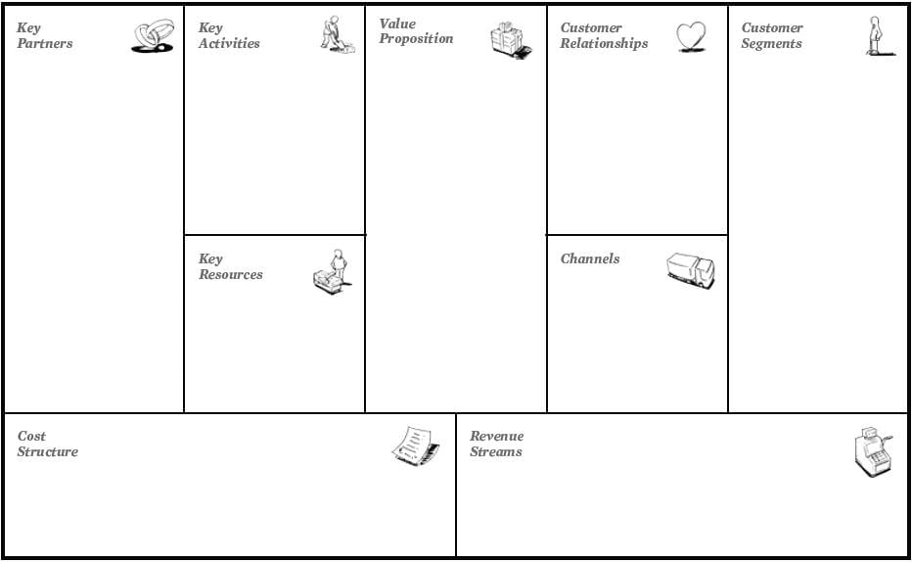

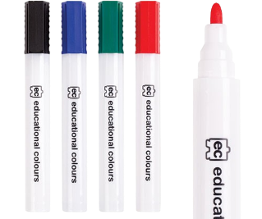
Example- an artisanal coffe shop
“Canvas”
Why use the Business Model Canvas?
The advantages of the Business Model Canvas.
Business Model
Clear, simple, and structured visualization of objectives
Strategic planning
Dialogue
Understanding
Creativity
Analytical skills
Teamwork
Team building
How can I apply the Business Model Canvas to my company?
The human brain vs The Business model canvas
Draft or print the Business Model Canvas.
Place it on the wall or a whiteboard.
Finally, the group can begin to draft and discuss the most suitable business model!

Slide 41
Example- an artisanal coffe shop
Why use the Business Model Canvas?
The advantages of the Business Model Canvas.
Clear, simple, and structured visualization of objectives
Strategic planning
Dialogue
Understanding
Creativity
Analytical skills
Teamwork
Team building
The human brain vs The Business model canvas
How can I apply the Business Model Canvas to my company?
Draft or print the Business Model Canvas.
Place it on the wall or a whiteboard.
Finally, the group can begin to draft and discuss the most suitable business model!

Slide 42
2.1.
Why use the Business Model Canvas?
The advantages of the Business Model Canvas.
Example- an artisanal coffe shop
Clear, simple, and structured visualization of objectives
Strategic planning
Dialogue
Understanding
Creativity
Analytical skills
Teamwork
Team building
The human brain vs The Business model canvas
How can I apply the Business Model Canvas to my company?
Coloque-o na parede ou num quadro branco
Finally, the group can begin to draft and discuss the most suitable business model!
Draft or print the Business Model Canvas.

Slide 43
Example- an artisanal coffe shop
Why use the Business Model Canvas?
The advantages of the Business Model Canvas.
Clear, simple, and structured visualization of objectives
Strategic planning
Dialogue
Understanding
Creativity
Analytical skills
Teamwork
Team building
The human brain vs The Business model canvas
How can I apply the Business Model Canvas to my company?
Draft or print the Business Model Canvas.
Place it on the wall or a whiteboard.
Finally, the group can begin to draft and discuss the most suitable business model!

Slide 44
Why use the Business Model Canvas?
The advantages of the Business Model Canvas.
How can I apply the Business Model Canvas to my company?
Clear, simple, and structured visualization of objectives
Strategic planning
Dialogue
Understanding
Creativity
Analytical skills
Teamwork
Team building
Example- an artisanal coffe shop
Draw or print the Business Model Canvas.
Place it on the wall
or a whiteboard.
Finally, the group can begin to draft and discuss the most suitable business model!
The human brain vs The Business model canvas

Slide 45
Example- an artisanal coffe shop
Why use the Business Model Canvas?
The advantages of the Business Model Canvas.
Clear, simple, and structured visualization of objectives
Strategic planning
Dialogue
Understanding
Creativity
Analytical skills
Teamwork
Team building
The human brain vs The Business model canvas
How can I apply the Business Model Canvas to my company?
Draft or print the Business Model Canvas.
Place it on the wall or a whiteboard.
Finally, the group can begin to draft and discuss the most suitable business model!

Slide 46
2.3.
Example- an artisanal coffe shop
Why use the Business Model Canvas?
The advantages of the Business Model Canvas.
Clear, simple, and structured visualization of objectives
Strategic planning
Dialogue
Understanding
Creativity
Analytical skills
Teamwork
Team building
Personalized
Costumer service
Offering high quality coffee
Coffee Lovers
Customer retention
Those seeking a
nice environment
to work
Physicall
store
Social media
and
a website
The human brain vs The Business model canvas
Coffee and coffee related products’ sales
Monthly subscriptions
How can I apply the Business Model Canvas to my company?
Draft or print the Business Model Canvas.
Place it on the wall or a whiteboard.
Finally, the group can begin to draft and discuss the most suitable business model!

Slide 47
2.3.
Example- an artisanal coffe shop
Why use the Business Model Canvas?
The advantages of the Business Model Canvas.
Clear, simple, and structured visualization of objectives
Strategic planning
Dialogue
Understanding
Creativity
Analytical skills
Teamwork
Team building
Preparação e
venda de cafés e produtos
relacionados
Personalized
Costumer service
Marketing e presença nas redes sociais
High quality suppliers
Offering high quality coffee
Coffee Lovers
Customer retention
Designers for interior decoration and merchandising
Those seeking a
nice environment
to work
A specialized
team
Store
Physicall
store
Influencers
High quality
Coffee grains
Social media
and
a website
The human brain vs The Business model canvas
Grains and other production related resources
Rent, utilities (water, electricity, etc.).
Coffee and coffee related products’ sales
Salaries
Monthly subscriptions
How can I apply the Business Model Canvas to my company?
Draft or print the Business Model Canvas.
Place it on the wall or a whiteboard.
Finally, the group can begin to draft and discuss the most suitable business model!

Slide 48
Example- an artisanal coffe shop
Why use the Business Model Canvas?
The advantages of the Business Model Canvas.
Clear, simple, and structured visualization of objectives
Strategic planning
Dialogue
Understanding
Creativity
Analytical skills
Teamwork
Team building
The human brain vs The Business model canvas
How can I apply the Business Model Canvas to my company?
Draft or print the Business Model Canvas.
Place it on the wall or a whiteboard.
Finally, the group can begin to draft and discuss the most suitable business model!

Slide 49
Why use the Business Model Canvas?
The advantages of the Business Model Canvas.
The human brain vs The Business model canvas
Clear, simple, and structured visualization of objectives
Strategic planning
Dialogue
Understanding
Creativity
Analytical skills
Teamwork
Team building
Example- an artisanal coffe shop
Left side of the brain
Right side of the brain
LOGICS
EMOTION
How can I apply the Business Model Canvas to my company?
Draft or print the Business Model Canvas.
Coloque-o na parede ou num quadro branco
Finally, the group can begin to draft and discuss the most suitable business model!

Slide 50
The human brain vs The Business model canvas
Left side of the canvas
Right side of the canvas
EFFICIENCY
Costumer
Key
VALUE
Activities
Relationships
Value
Customer
Segments
Key
Propositions
Partnerships
Key Resources
Channels
Cost Structure
Revenue Streams

Slide 51
THANK YOU
THANK YOU
THANK YOU
Avenida Manuel Violas, nº 476
4410-137 São Félix da Marinha
(+351) 227 334 140(1)
inova@inovagaia.pt

